Slide 1

Motion planning for Mobile Robot
Under the supervision of Dr. Mani Prakash, Ph.D.
119ME0033
J.Ravikiran

Slide 2
Content
Mobile robot and types
Robot Kinematics
Types of Wheels
Robot Dynamics
Sensing and Perception
Classification and Commonly used sensors
Localization of mobile robot
Differential drive kinematic equations
Path planning
Motion Control
Final Model
References

Slide 3
Mobile robot and types
A mobile robot is an automatic machine that is capable of locomotion(effector its move due to its action on environment)
Mobile robot covers that roll, walk, fly or swim i.e,land-based, air-based, water-based,..etc
Types of land-based mobile robots wheeled, legged, tracked, hybrid
Wheels are more suitable and effective on flat surface than legs along with more stability
Legged mobile robot requires higher degree of freedom which make its mechanically complex

Slide 4
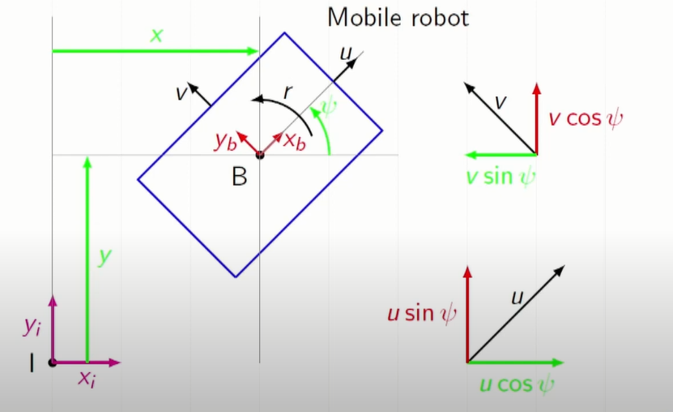
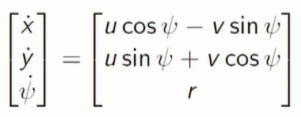

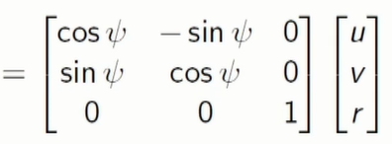



Robot Kinematics
-velocity input commands
-Jacobian matix which
maps input of coordinates
-derivatives of generalized coordinates
-wheel input or configuration matrix
-wheel angular velocity
x: Forward displacement of the mobile robot w.r.t. I y: Lateral displacement of the mobile robot w.r.t. I : Angular displacement of the mobile robot w.r.t. I
u: Forward velocity of the mobile robot w.r.t. B v: Lateral velocity of the mobile robot w.r.t. B
r: Angular velocity of the mobile robot w.r.t. B.
W
ω

Slide 5


Kinematics is the study of motion that concerned with the motion of objects without reference to the forces which cause the motion
Forward differential kinematics:-For given velocity input commands, finding the derivatives of generalized coordinates (finding the system’s motion).
Simulating or analyzing the system in velocity level. Inverse differential kinematics:-For the desired (given) derivatives of generalized coordinates (or given position trajectory), finding the corresponding velocity input commands.
Controlling the system in velocity level.

Slide 6
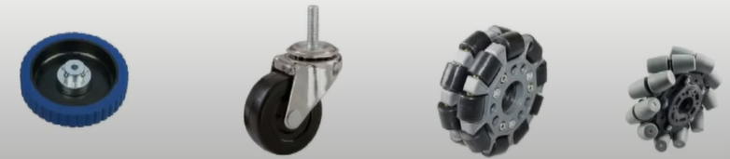
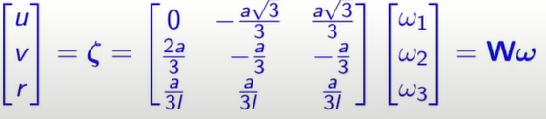
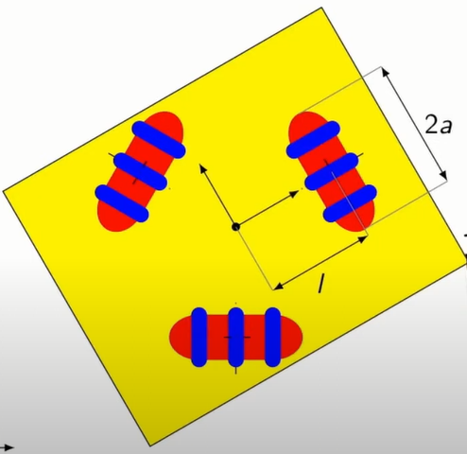
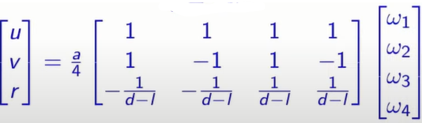
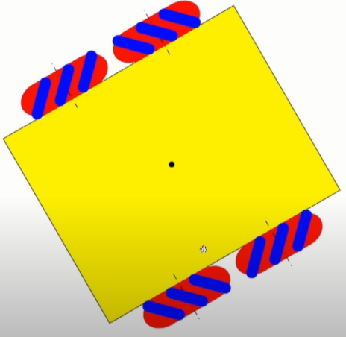
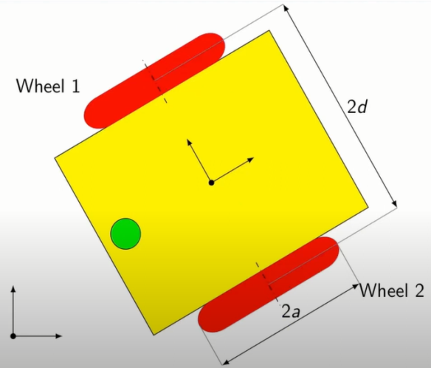
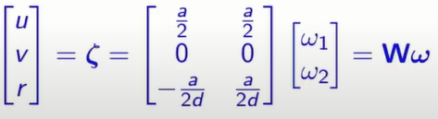
Types of Wheels
Solid Wheels
Conventional Wheels
Fixed Wheels
Steered or Rotatable wheels
Non-conventional Wheels
Omni-directional wheels
Mecanum wheels
Inflated Wheels(filled with air)
Omni-directional
Wheel drive
Differential wheel drive
Mecanum wheel drive

Slide 7




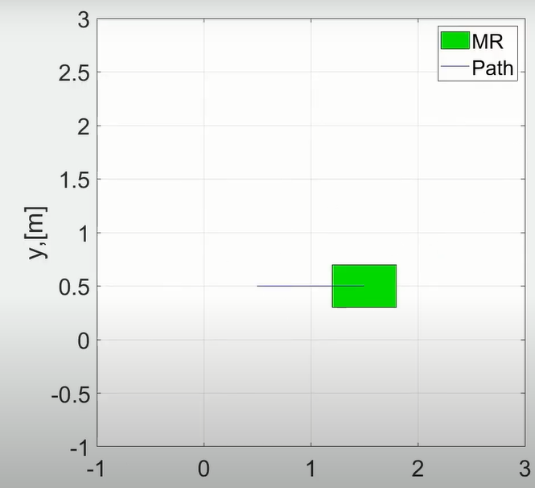
Matlab script and Eulers method
Using Euler method and replacing “x” with and
Giving the
based on the wheel
configuration
And assigning the
angular velocity of each
wheel forward
kinematics can be
achieved

Slide 8



Robot Dynamics
Dynamics is the study of system that undergo change of state as time evolves.
In case of mechanical system such as robots, the change of states involves motion
Forward dynamics: For a given input vector , calculating the resulting motion of the robot, that is , problem of simulating or analyzing the robot Inverse dynamics: For a given desired trajectory ,
find the required input vector, . problem of controlling the robot

Slide 9
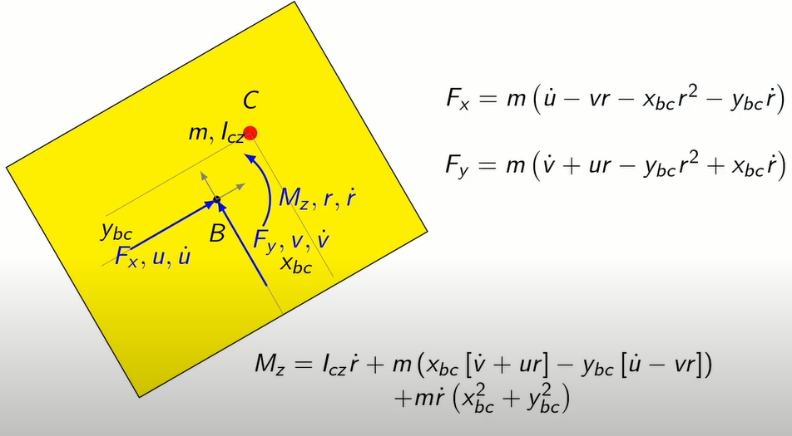
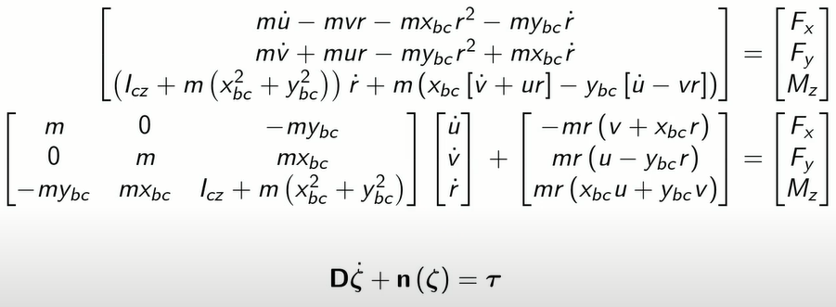



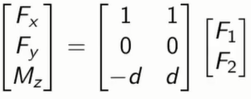
Equation of motion
w.k.t, from kinematic relations
Applying Euler method to i.e,
From the dynamic relations we get
Again we can write as = Γk, Γ-mapping & k-wheel force
Γ is different for different wheel drives
For ex: differential drive , d-distance b/t wheels

Slide 10
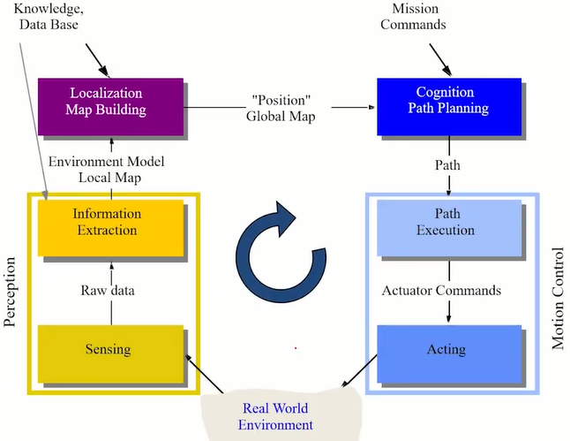
Sensing and Perception
Perception is of translating sensory impressions into a coherent and unified view of the world around
Feature extraction
Matching (association)
Updating
Model Integration
Model
Prediction

Slide 11
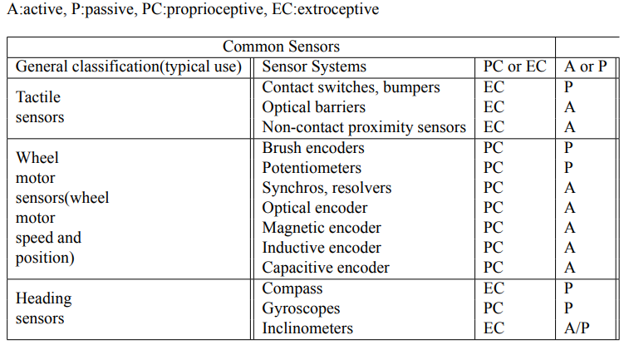
Classification and Commonly used sensors
Tactile Sensors – detection of physical contact or closenss
Wheel/motor sensors – wheel motor speed and position
Heading sensors – orientation of the robot in relation to a fixed reference frame

Slide 12
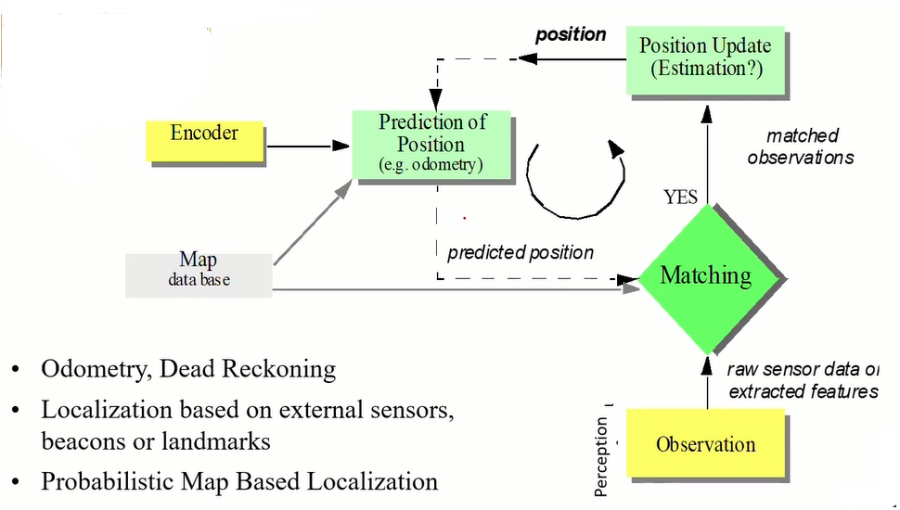
Localization of mobile robot

Slide 13
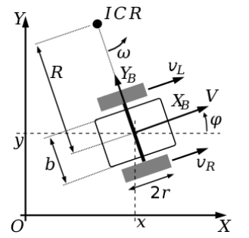
Differential drive kinematic equations
Forward Kinematics
For given velocities of right and left wheels finding the robots velocity
We know that in general v = rω from the figure r for right and left wheels are R + (b/2) and R − (b/2) respectively where b is the base of the robot.
Hence we can write
VR = (R + (b/2))ωrob & VL = (R − (b/2))ωrob
⇒ Vrob = (VL + VR)/2 = (ωL + ωR)/(2 ∗ r)
From VR & VL we get,
ωrob = (VR − VL)/b & R = Vrob/ωrob
⇒ R = b(VL + VR)/2(VR − VL)

Slide 14
Differential drive kinematic equations
Inverse Kinematics
For desired ωrob & Vrob i.e, Vrob = (VL + VR)/2 &
ωrob = (VR − VL)/b we need to find individual wheel velocities.
On solving these both we get,
VR = Vrob + ωrob(b/2) ⇒ ωR = (Vrob + ωrob(b/2))/r & VL = Vrob − ωrob(b/2) =⇒ ωL = (Vrob − ωrob(b/2))r

Slide 15
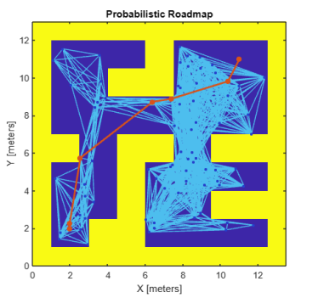
Path planning
Probabilistic Road Map(PRM) - Random node are made in the space and then they are connected making a network of paths. Access by “mobileRobotPRM(map)” for a map
A* algorithm - uses a function f(n) = g(n) + h(n) to find the optimal from start and goal points, where g(n) & h(n) are the function to find the distance to reach from start to n th node and n th node to goal
finder is used to execute it in matlab

Slide 16
Motion Control
ControllerPurePursuit - takes desired linear and angular velocities along with look ahead distance of pursuiter
controller function is used to find the reference linear and angular velocities of the pursuiter with respect to the pose
Inverse kinematic equations are used to find the individual wheel’s velocities with respect to reference velocity found before as desired robots velocity
Forward kinematic equations are made to make the robot move using the individual wheel velocities found in the previous step

Slide 17
Final Model
The parameter for the simulation are assigned Wheeled robot’s parameters are given
Initial pose/eta is allotted. Map is loaded and inflation in made so that obstacle’s can’t enter robot’s cartesian space
Waypoints will be assigned in case of fixed path
planner is used to initialize PRM to the map with given number of node and the distance between the nodes
Start and goal point are allotted
A* algorithm is used to find the optimal waypoints to reach the goal
2D visuailization of the map is made with the help of visualizer

Slide 18
controllerPurePursuit takes desired linear and angular velocities along with look ahead distance of pursuiter
Inverse kinematics is used to find the individual wheel’s velocities with respect to reference velocity found before as desired robots velocity
Forward kinematics is made to make the robot move using the individual wheel velocities found in the previous step
Using matlab viz2D - Visualization of motion is made with respect to the eta/pose through waypoints with are given rate

Slide 19
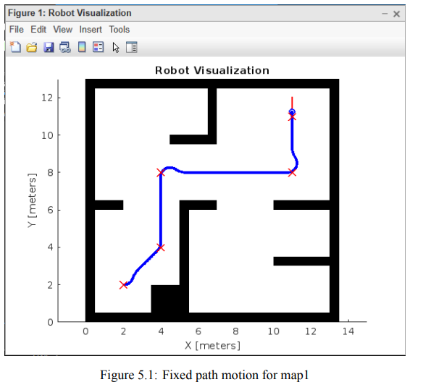
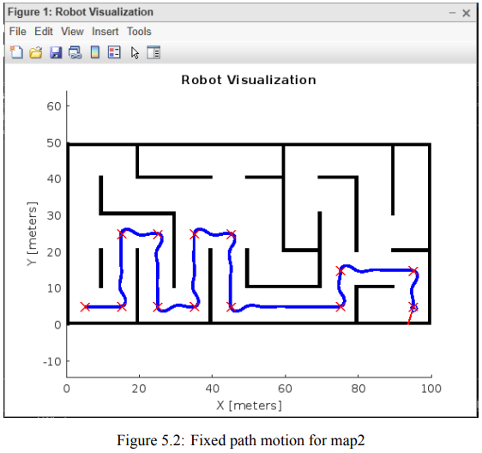
Fixed path motion

Slide 20
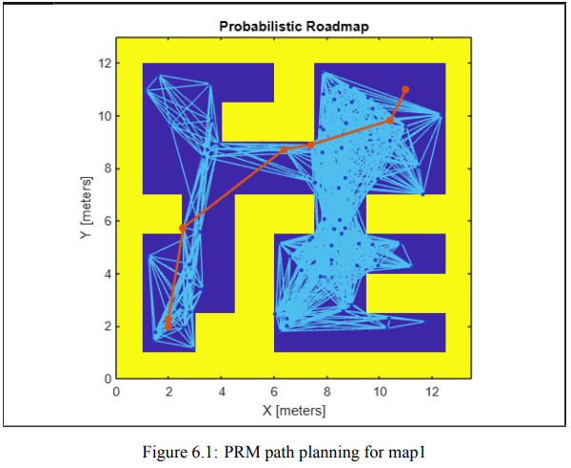
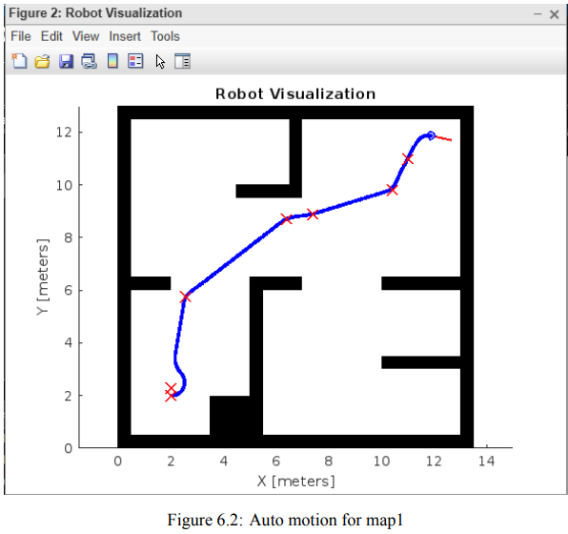
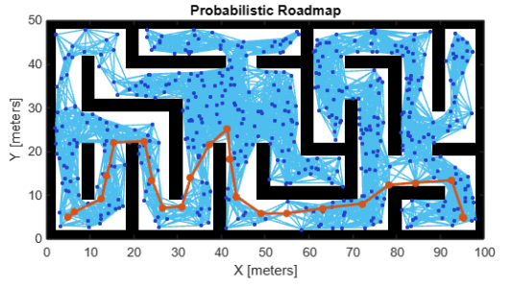
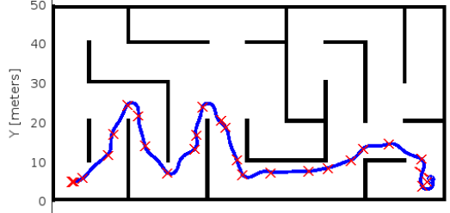
Auto path motion

Slide 21
Future Scope
The use of sensors wheeled mobile robot can even avoid the dynamic obstacles which will be a major advantage. As in real life the dynamic obstacle are a common scenario
Making of sensors to be able to navigate in an unknown territory that are in term called as SLAM robot that is robots that can Simultaneous Localization and Mapping for better performance
The path planning and motion planning can be advanced in separately then they can be used not only for wheeled mobile robot but also for other field robots providing better results

Slide 22
Conclusion
Motion planning for wheeled mobile robot in a given map provided there are no dynamic obstacles this is done for one of the wheel drives discussed above namely Differential Drive.
With algorithms and the kinematics both forward &inverse kinematics equations to accomplish the task
Probabilistic Road Map(PRM) followed by A*algorithm completes the path planning
The motion controlling that is made possible with the help of one of the matlab function controlPurePursuit which is then combined its results with inverse and forward kinematics of the differential drive.
And the vizualization is along made to make the things more like simulation

Slide 23
References
Wheeled Mobile Robot - an overview | ScienceDirect Topics
Wheeled Mobile Robots - Course (nptel.ac.in)
112106298.pdf - Google Drive
(PDF) Localization of Wheeled Mobile Robot Based on Extended Kalman Filtering (researchgate.net)
(PDF) Localization of Wheeled Mobile Robot Based on Extended Kalman Filtering (researchgate.net)
(PDF) Mobile Robot Kinematic Reconfigurability for Rough-Terrain (researchgate.net)
Control of a nonholonomic mobile robot: backstepping kinematics into dynamics | IEEE Conference Publication | IEEE Xplore
Mobile Robot Control on a Reference Path | IEEE Conference Publication | IEEE Xplore

